Slide 1
PROBABILITY
So, you’re saying there’s a chance!

Slide 2
5.1 Basic Probability
Probability Defined: A Measure of Chance
or, the likelihood of an event happening
Prob Notation: P(A) Prob of event A “P of A”
Prob Found: # of desired results/# of total results f/n
0<= P<=1

Slide 3

Marbles

Slide 4
Complement
The complement of an event: P(not the event)
P(not A). Written as P(A’)
P(A)+P(A’)=1…
So, P(A’)= 1-P(A)

Slide 5
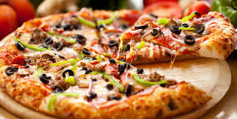
Pizza

Slide 6
Prob vs Stat
Stats: the sample is known
We draw conclusions about the population based on the results of our sample.
Prob: the population is known
We ask “what are the chances…what is the likelihood on this try?” we are asking about this sample.
Stats reasons from the sample toward the population
Prob reasons from the population toward the sample

